Slide 1

Oden Blog
It’s a blog website, versatile and effective way to publish content.

Slide 2
TEAM MEMBER’S
Abhishek Bhardwaj
Vishal Chauhan

Slide 3
Abstract
01
Introduction
02
TABLE OF CONTENTS
Objective
03
Project design
04
Future scope
05

Slide 4
Abstract
A blog website is a versatile and effective way to publish content, engage with your audience, and promote your business or personal brand.
It also used for posting the blogs, editing the blogs, deleting the posted blogs etc. It is also used for viewing and posting the others one’s blogs/posts.
The Blog Website project aims to provide a comprehensive platform for users to create and publish their own blogs, with a strong focus on community building and help users succeed in the blogosphere.

Slide 5
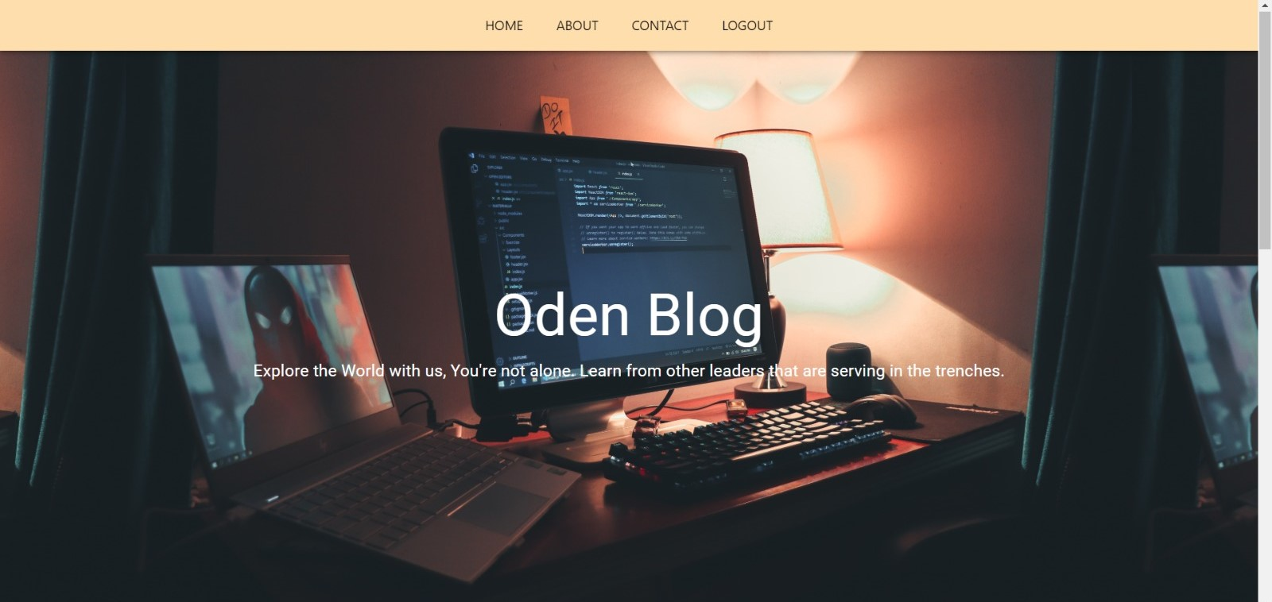
Introduction
A blog website is a type of website that typically contains a series of posts or articles written by an individual or a group of authors. Blog websites can cover a wide range of topics, from personal experiences and hobbies to news and current events, politics, business, technology, and more. They can be used for various purposes, such as personal expression, marketing, education, and communication.

Slide 6
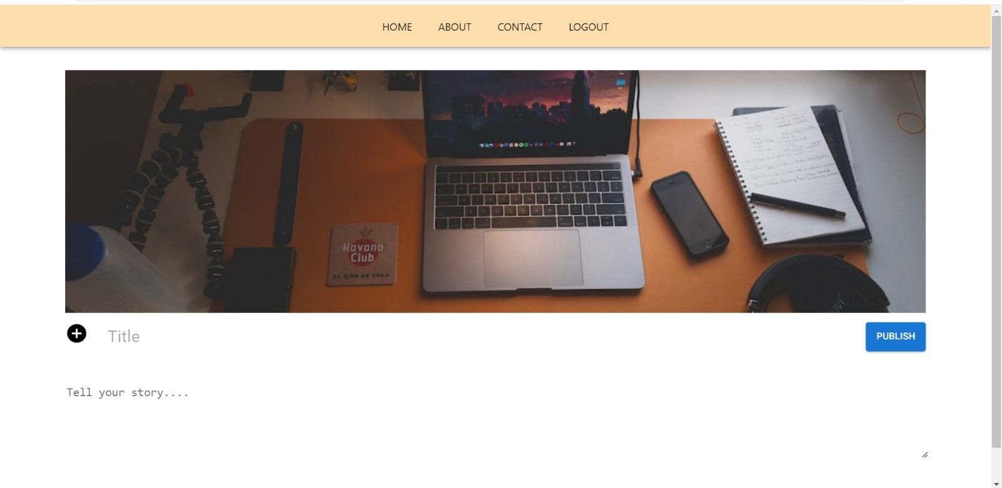
Objective
Content publishing: One of the main objectives of a blog website is to provide a platform for publishing high-quality and engaging content on a regular basis.
Audience engagement: Blog websites aim to engage with their audience through various means, such as comments, social media, email, and other interactive features.
Brand building: Blog websites can be used to build a personal or professional brand by showcasing the author's expertise, knowledge, and opinions on relevant topics.

Slide 7
CREATE BLOG

Slide 8
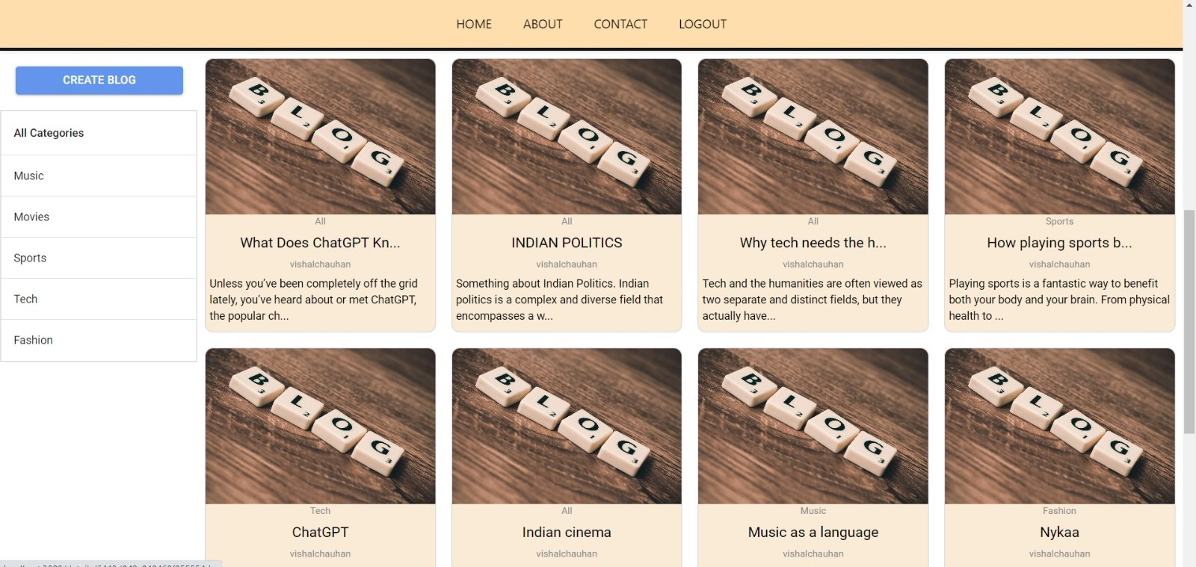
OUR BLOG’S

Slide 9
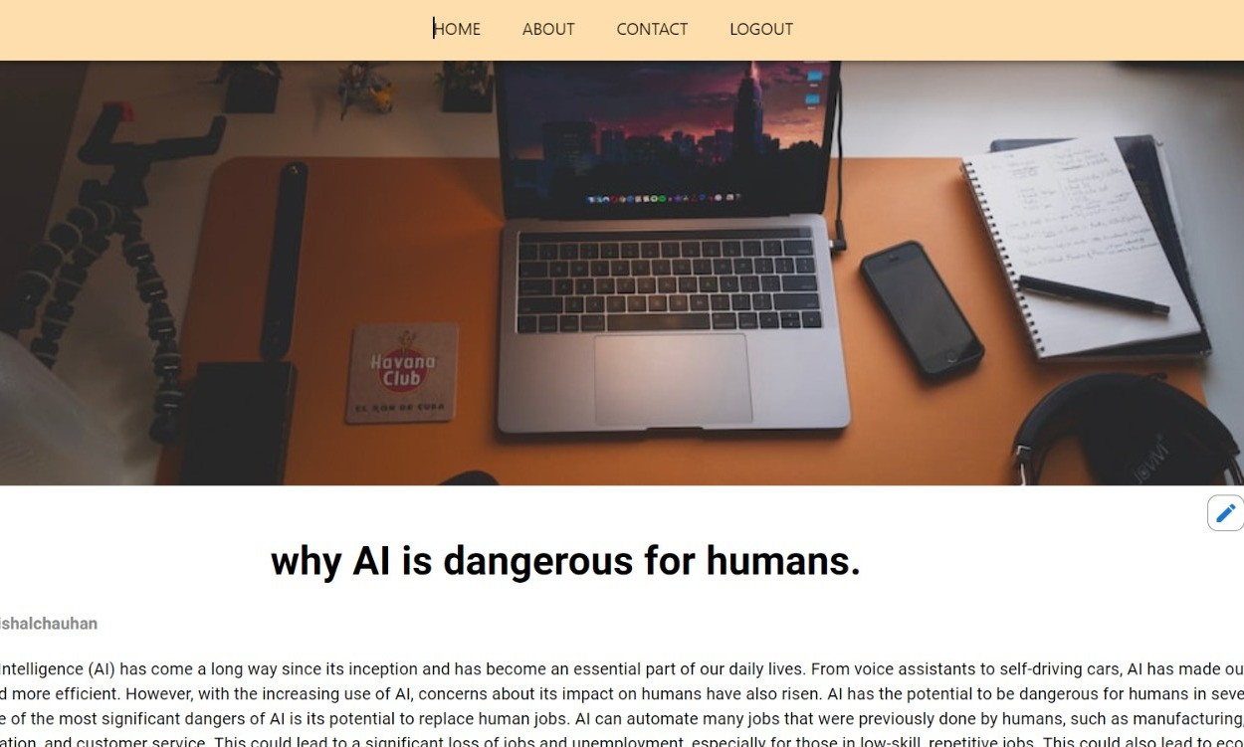
BLOG

Slide 10
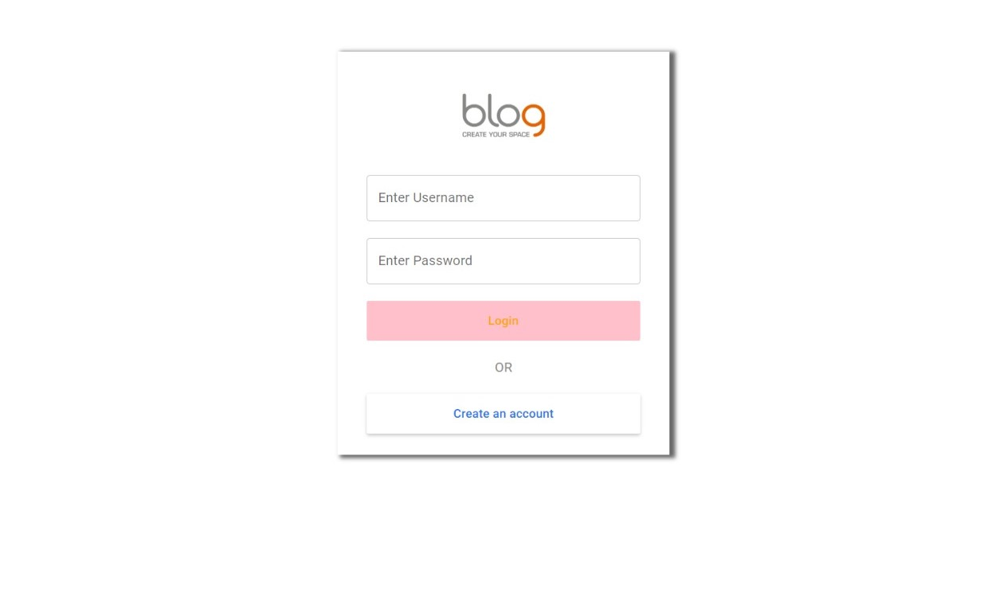
LOG IN

Slide 11
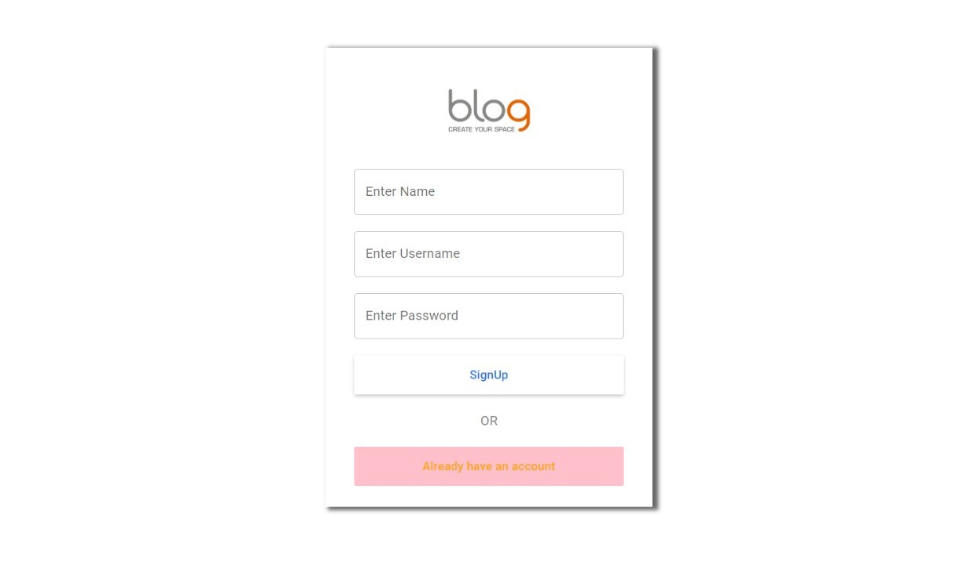
SIGN UP

Slide 12
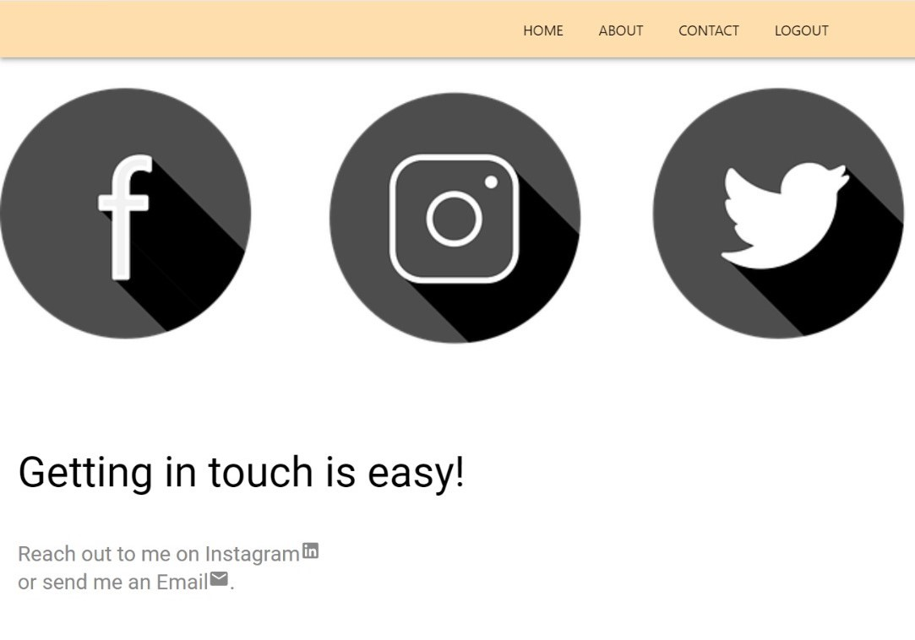
CONTACT US

Slide 13
HTML
REACT
NODE js
TECHNOLOGY USED
MONGODB
JAVASCRIPT
CSS

Slide 14
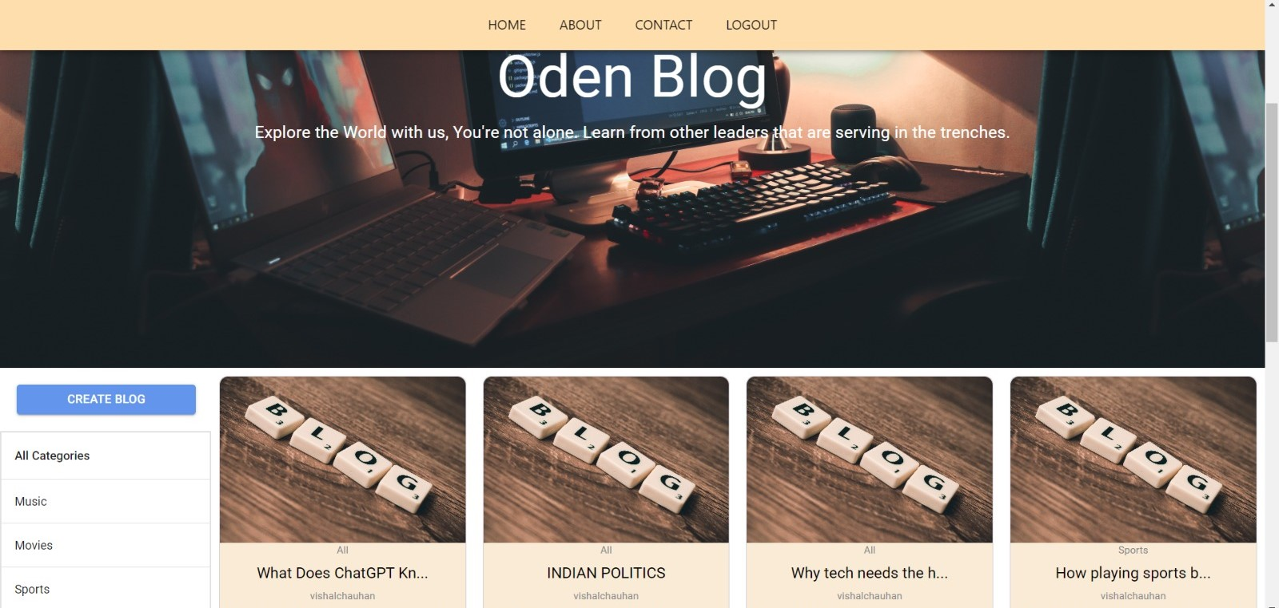
GOAL 1
PROJECT GOALS
GOAL 2
The primary goal of a blogging website is to provide value to its audience through the content that is published.
The goal of a blogging website is to create and maintain an online platform where high-quality, engaging content can be published on a regular basis.

Slide 15
FUTURE PROJECTS
MONETIZATION
SATURN
More focus on user experience

Slide 16
THANKS

